Slide 1
A JWST pure-parallel search for the first galaxies with PANORAMIC
Hanna Golawska
Supervisor: Dr Derek McLeod

Slide 2
Motivation
Expanding the sample of confirmed high-redshift ($z>13$) galaxies for robust statistical analysis
Investigating the process of galaxy formation and evolution
Placing constraints on the period in the history of the universe when galaxies started forming

Slide 3
Lyman-break galaxies
Lyman-$α$ break: $λ_{rest}=$ 1,216 Å
At redshift $z$ = 12: $λ_{obs}=$15,808 Å
Harikane et al. (2023)

Slide 4
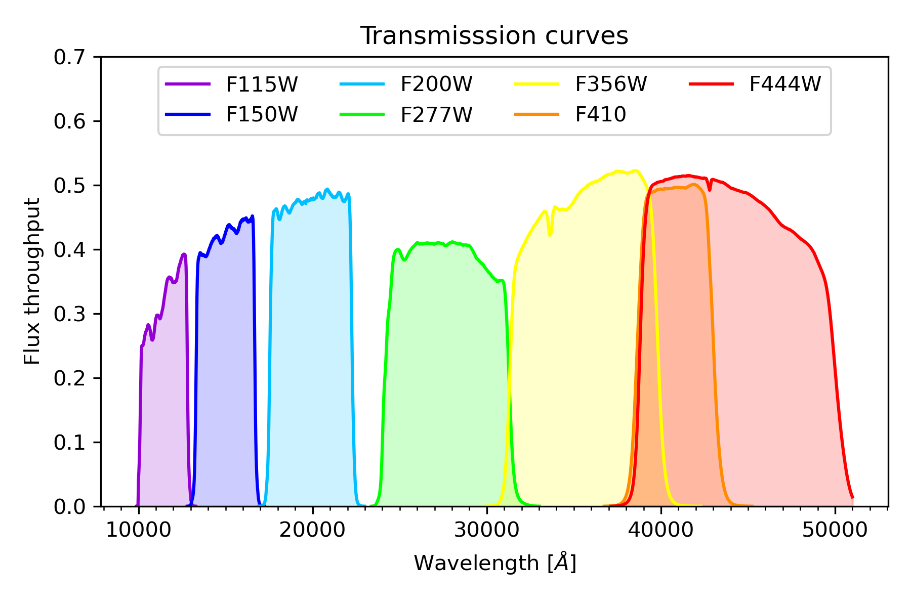
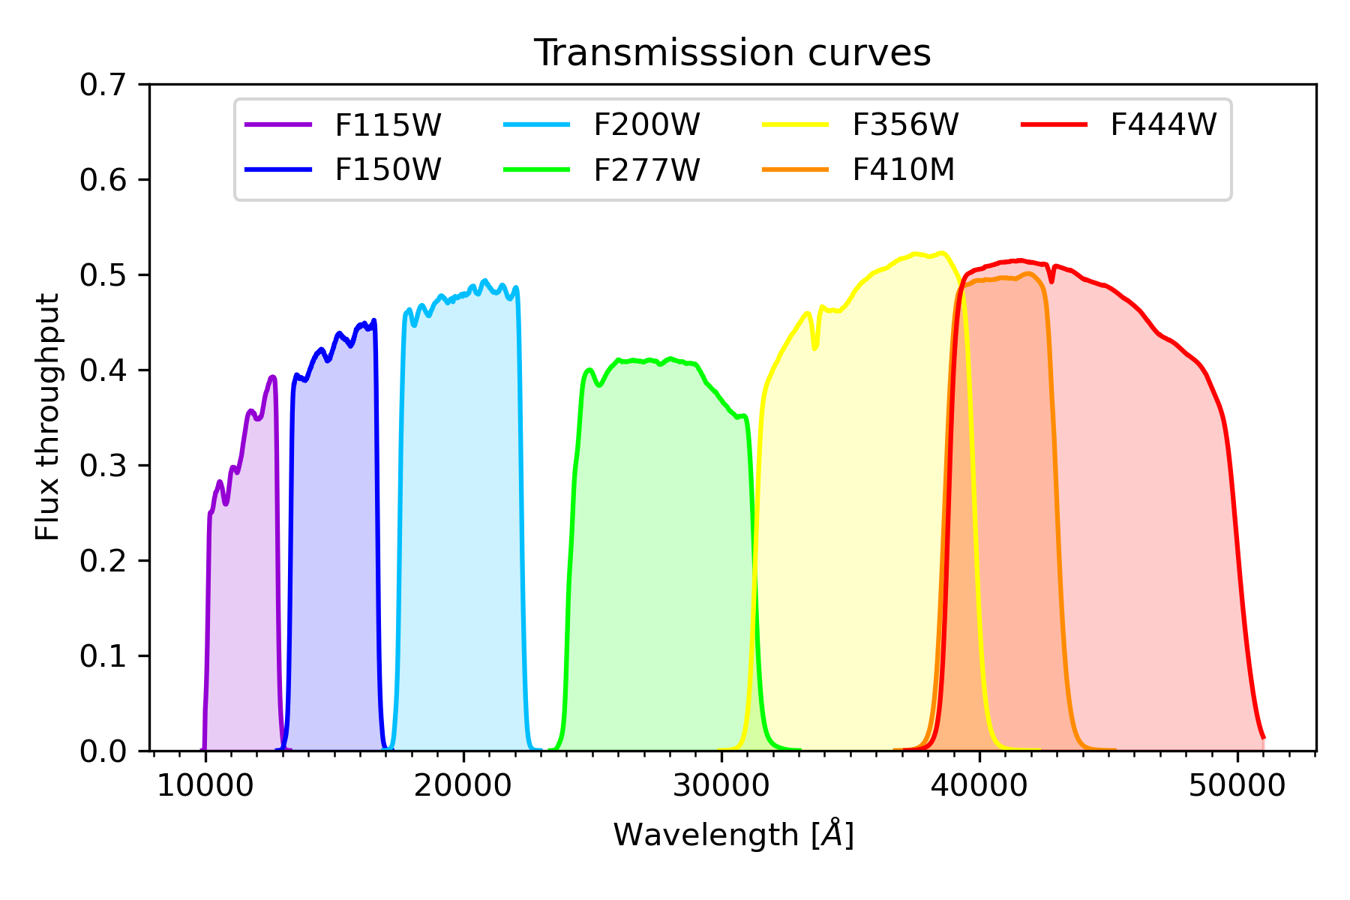
Data
PANORAMIC: 40 uncorrelated NIRCam pointings
Filters: F115W, F150W, F200W, F277W, F356W, F410M and F444W
Area of one image $\sim$ 10 arcmin$^{2}$

Slide 5
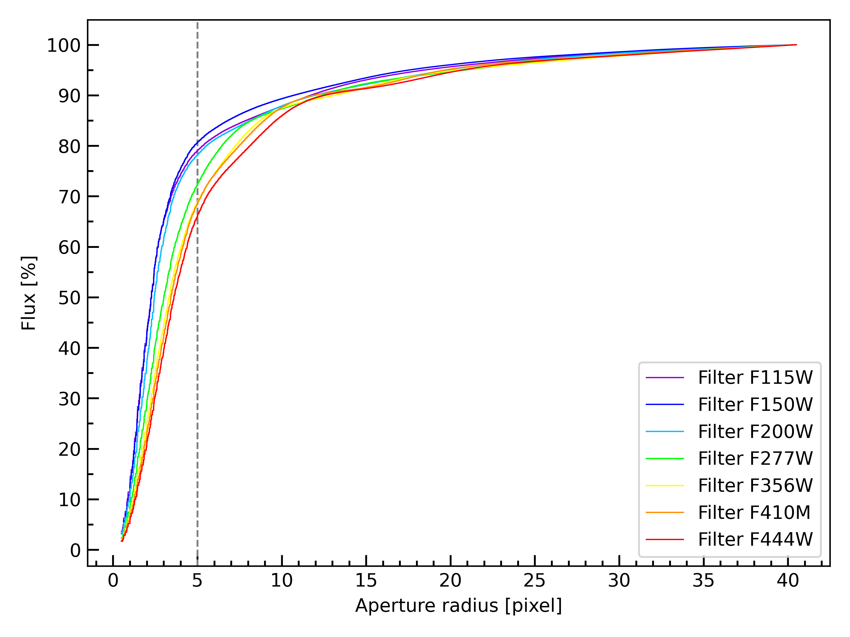
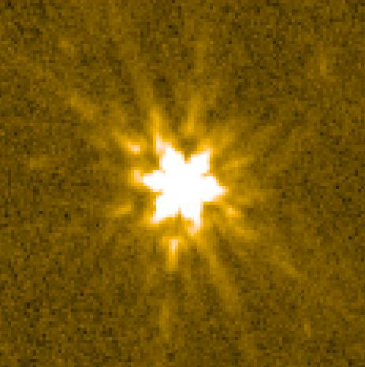
Point spread function correction
Measured fluxes in apertures of different radii
Choice of aperture: 5 pix (0.3 arcsec) radius

Slide 6
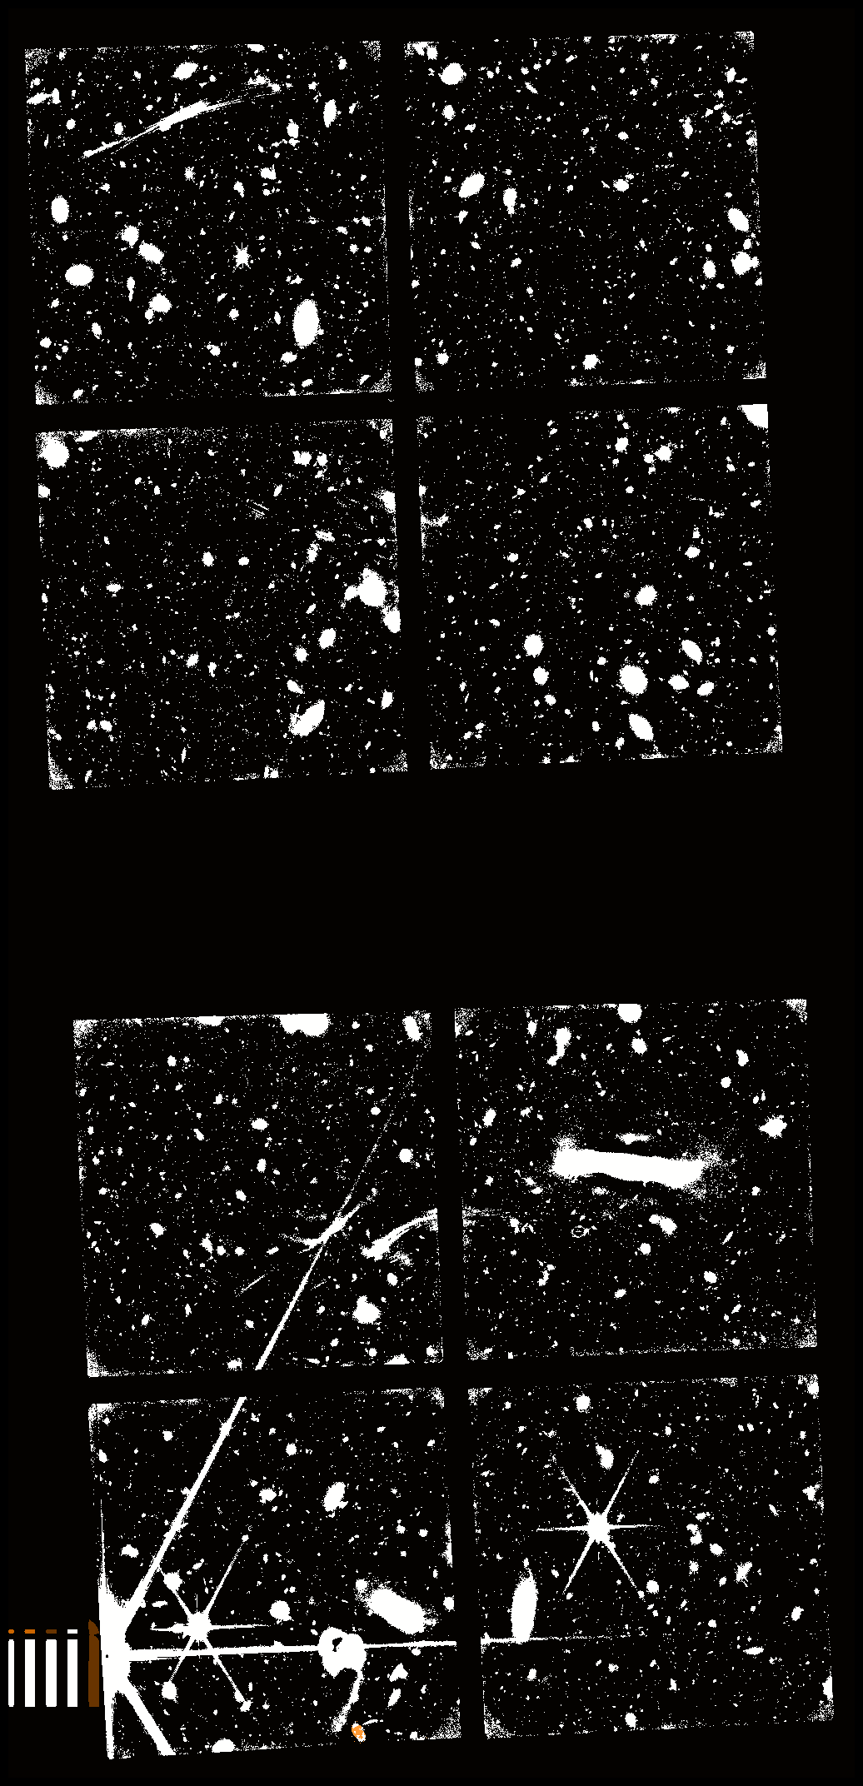
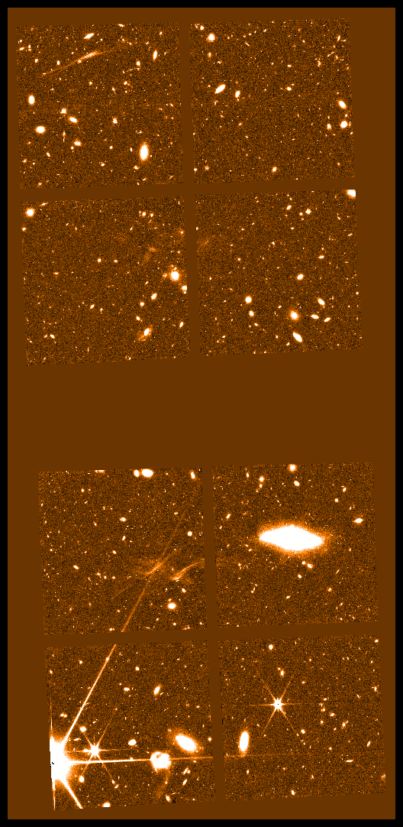
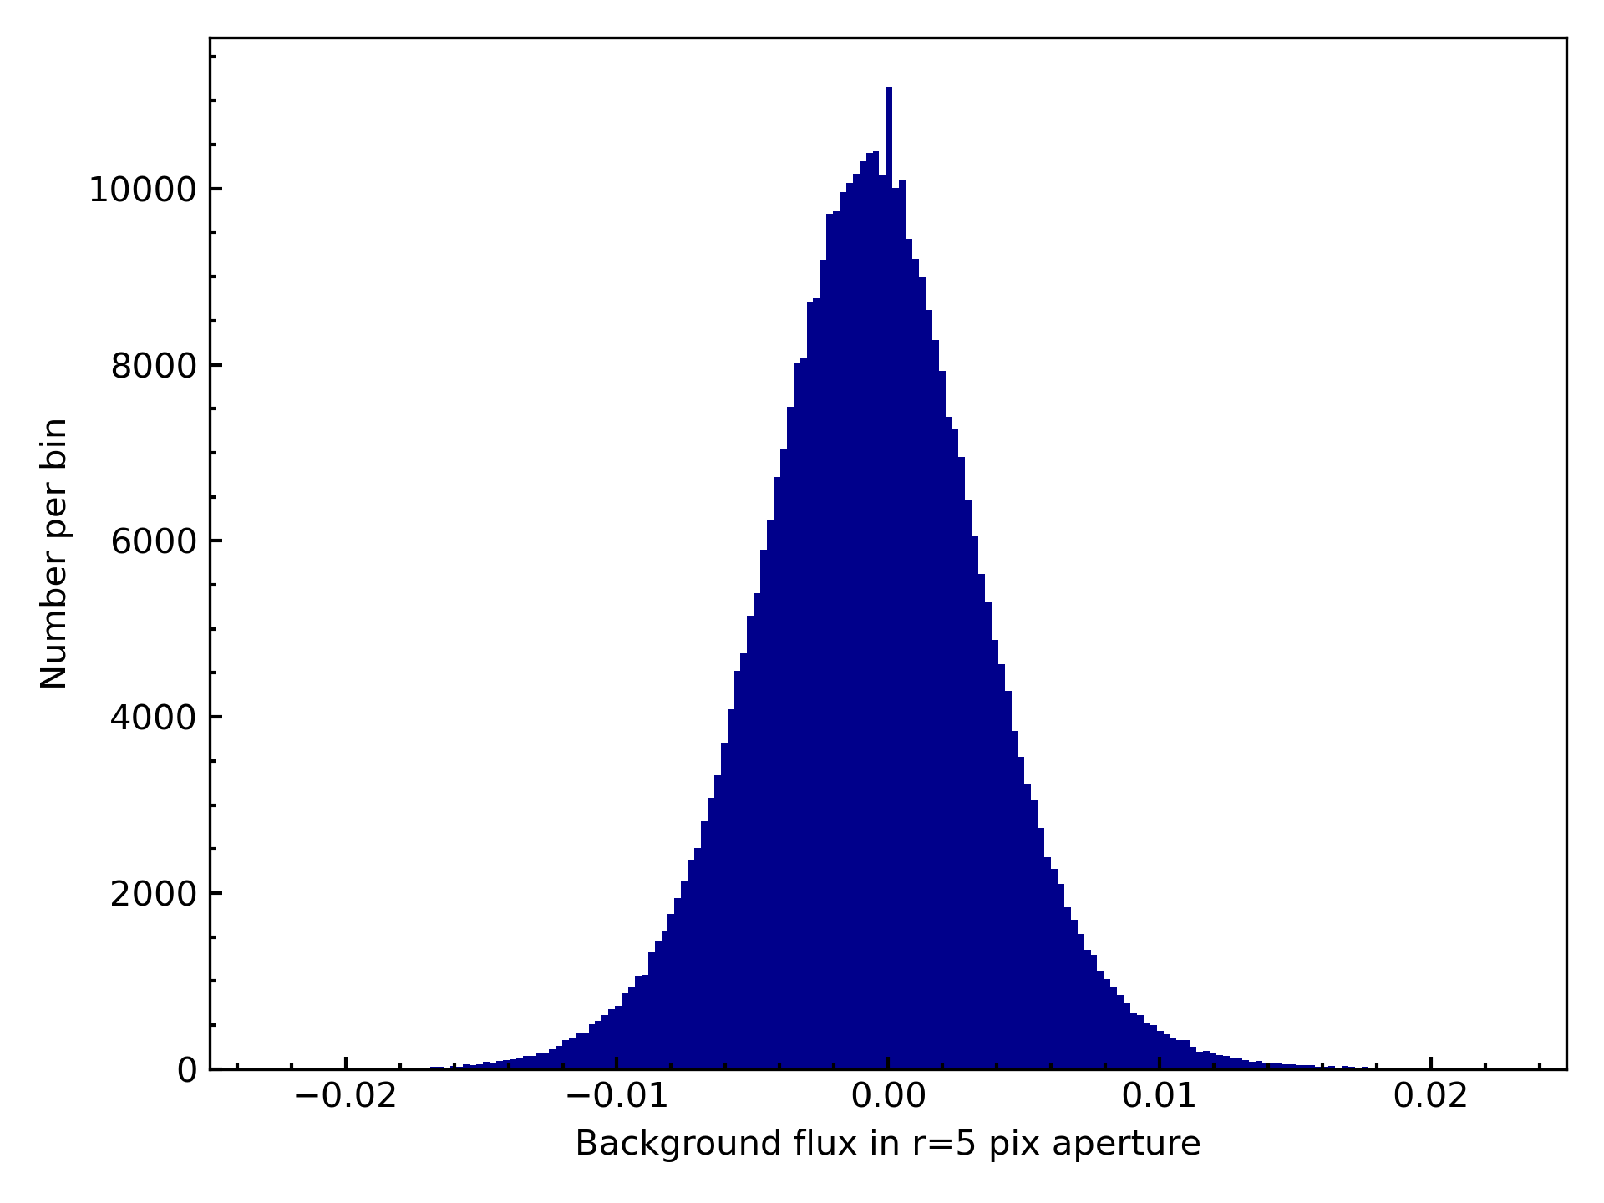
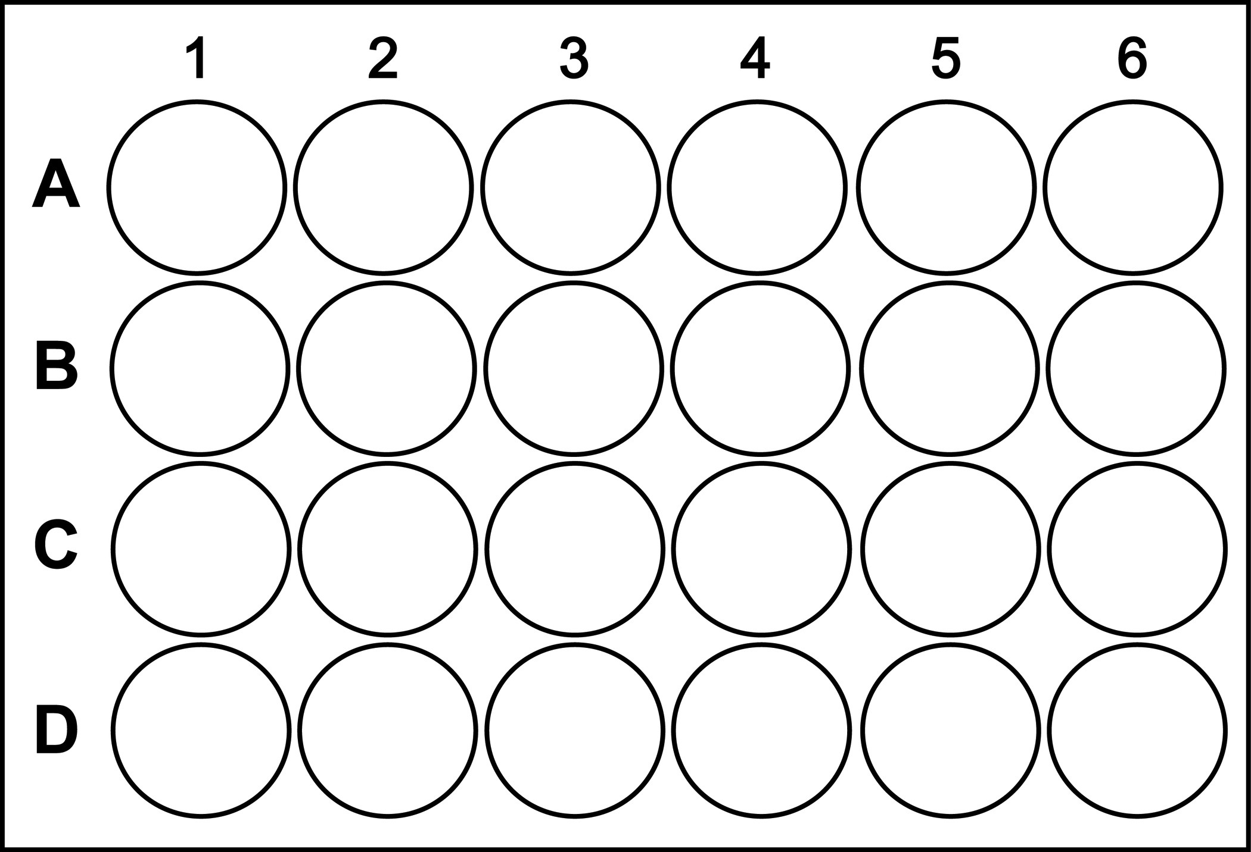
Global 5$σ$limiting magnitude
$$σ=1.4826 median(\left|f_{i} −median\right|)$$
Notes:
median of the absolute deviations from the data's median
scaled median absolute deviation

Slide 7
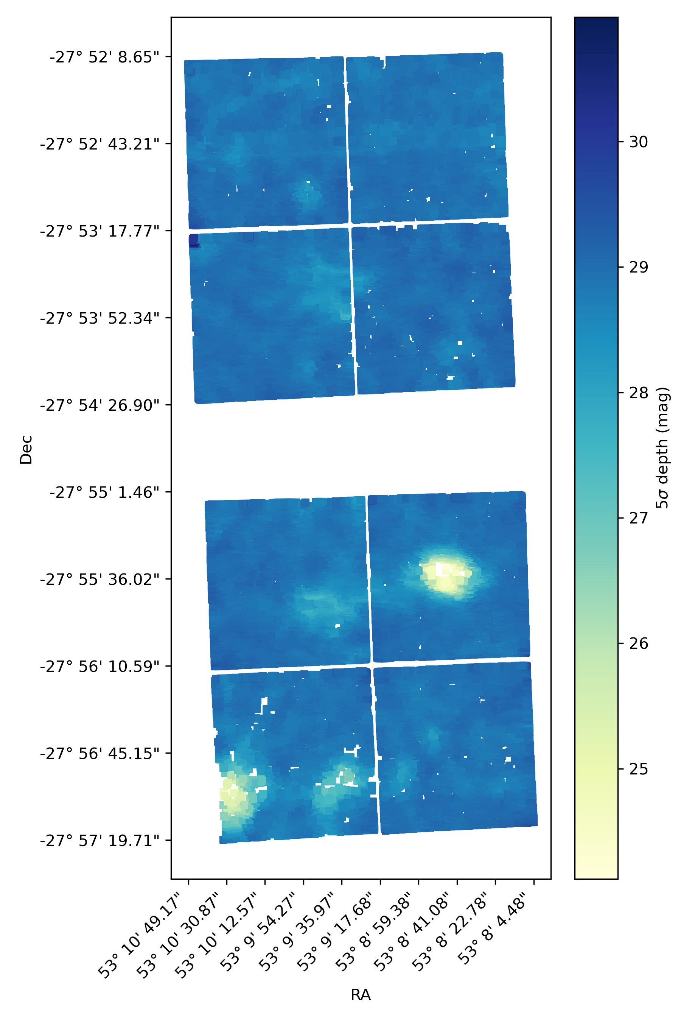
Depth map

Slide 8
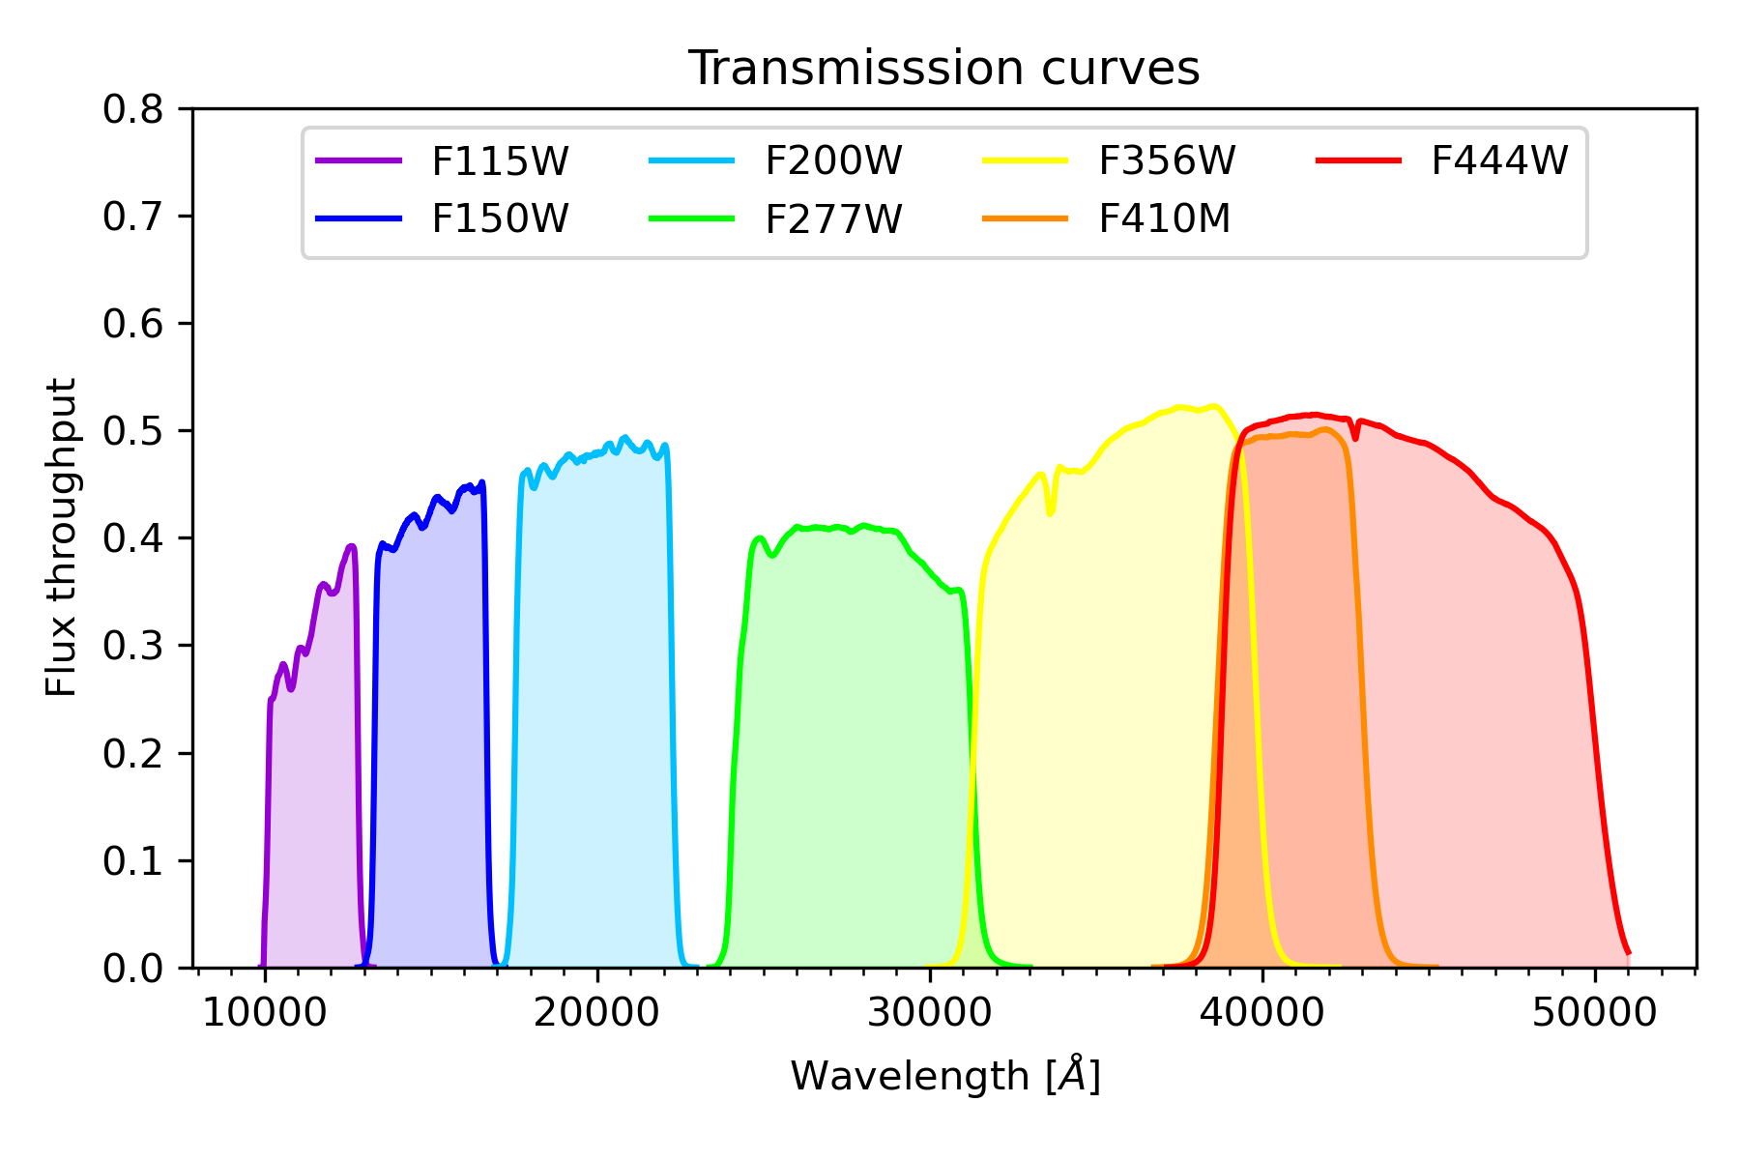
High $z$ candidate selection
detection filter
SNR > 5
additional detection in either of these
non-detection
SNR < 2

Slide 9
Visual inspection – discarded sources
Galaxy ID 17073
Galaxy ID 5681
Galaxy ID 10471
Notes:
supplementary slide

Slide 10
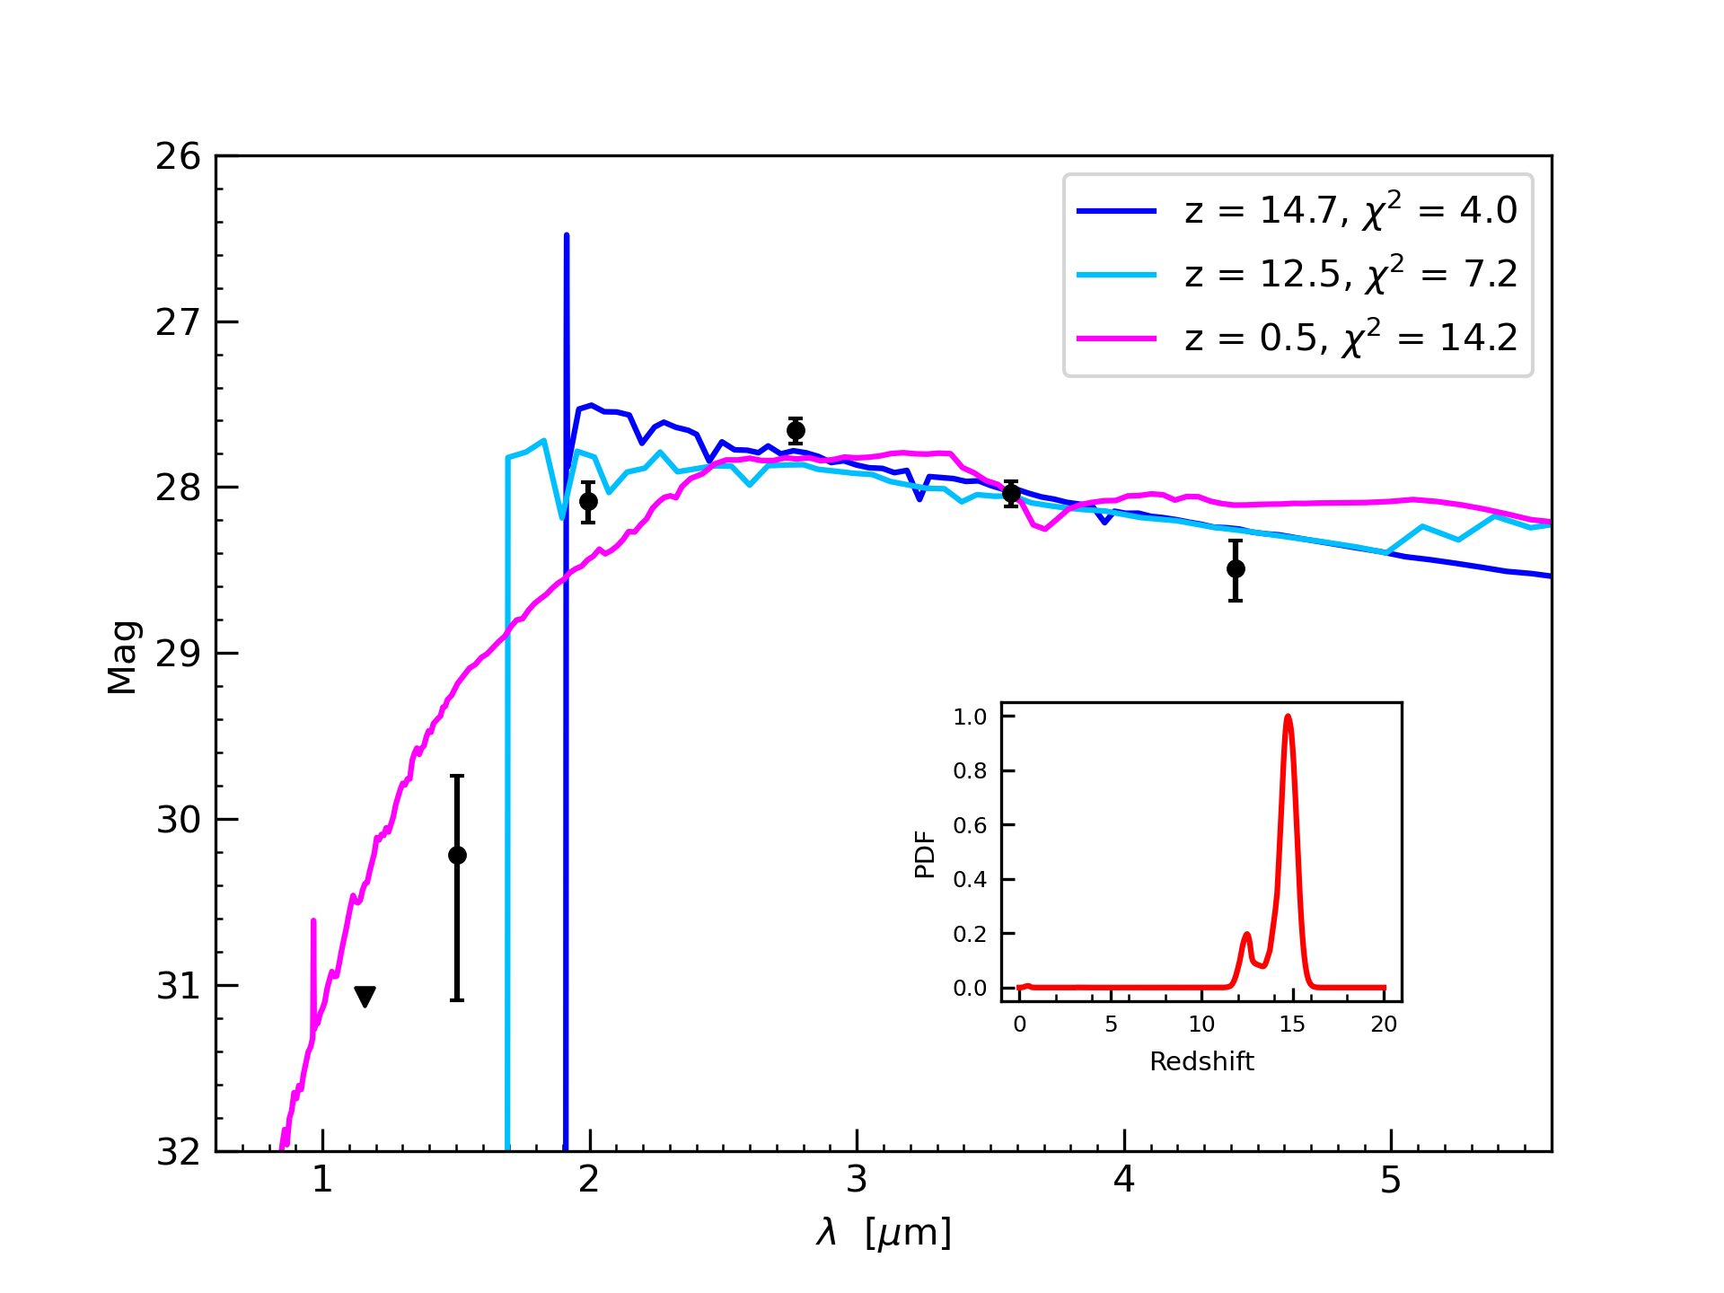
Galaxy 3899
$z_{best}>9.5$
$χ_{sec}^{2} −χ_{best}^{2}>4$
$χ_{best}^{2}<20$
Notes:
3 solutions bc 12.5 is still a quite good solution, f150w stamp
m-dwarf star, fit stellar SED fits

Slide 11
Galaxy 2038
Notes:
more extended, def a galaxy

Slide 12
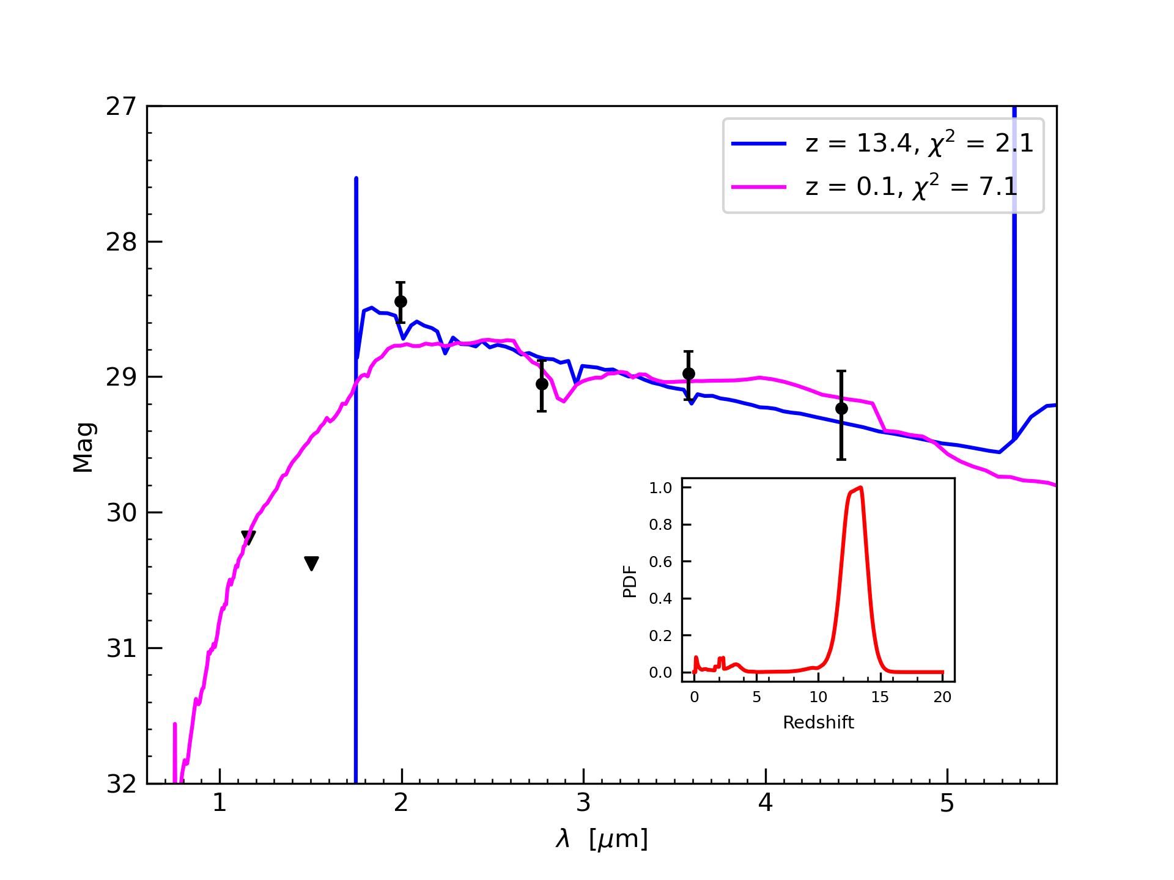
Galaxy 21152

Slide 13
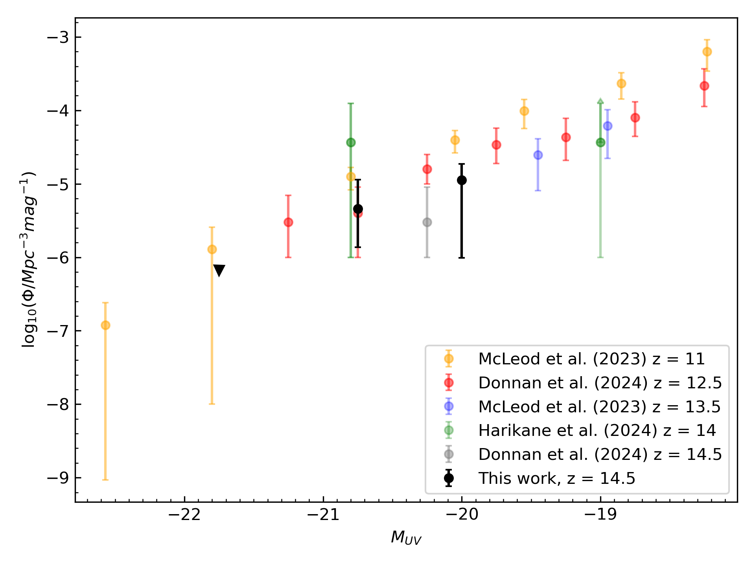
UV luminosity function
Notes:
preliminary
consistent with most of the previous work at similar redshifts

Slide 14
Next steps
Two JWST Cycle 4 proposals to confirm redshifts spectroscopically with NIRspec:
bright galaxies: single object spectroscopy, 2 hours of observation time
faint galaxy: multi-object spectroscopy

Slide 15
Thank you

